Slide 1
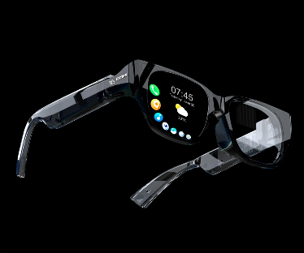
I-XRAY: The AI Glasses That Reveal Anyone’s Personal Details
A Case Study on Privacy, Ethics, and Technology
Presented By
MOHAN SAI Bandarupalli
mb2279

Slide 2
Introduction
What is I-XRAY?
AI-integrated wearable prototype using Meta's Ray-Ban smart glasses.
Enables real-time identification of individuals and access to personal data.
How Does It Work?
Captures facial scans using smart glasses.
Processes data via AI-based facial recognition algorithms.
Aggregates public data (names, addresses, social profiles) for instant display.

Slide 3
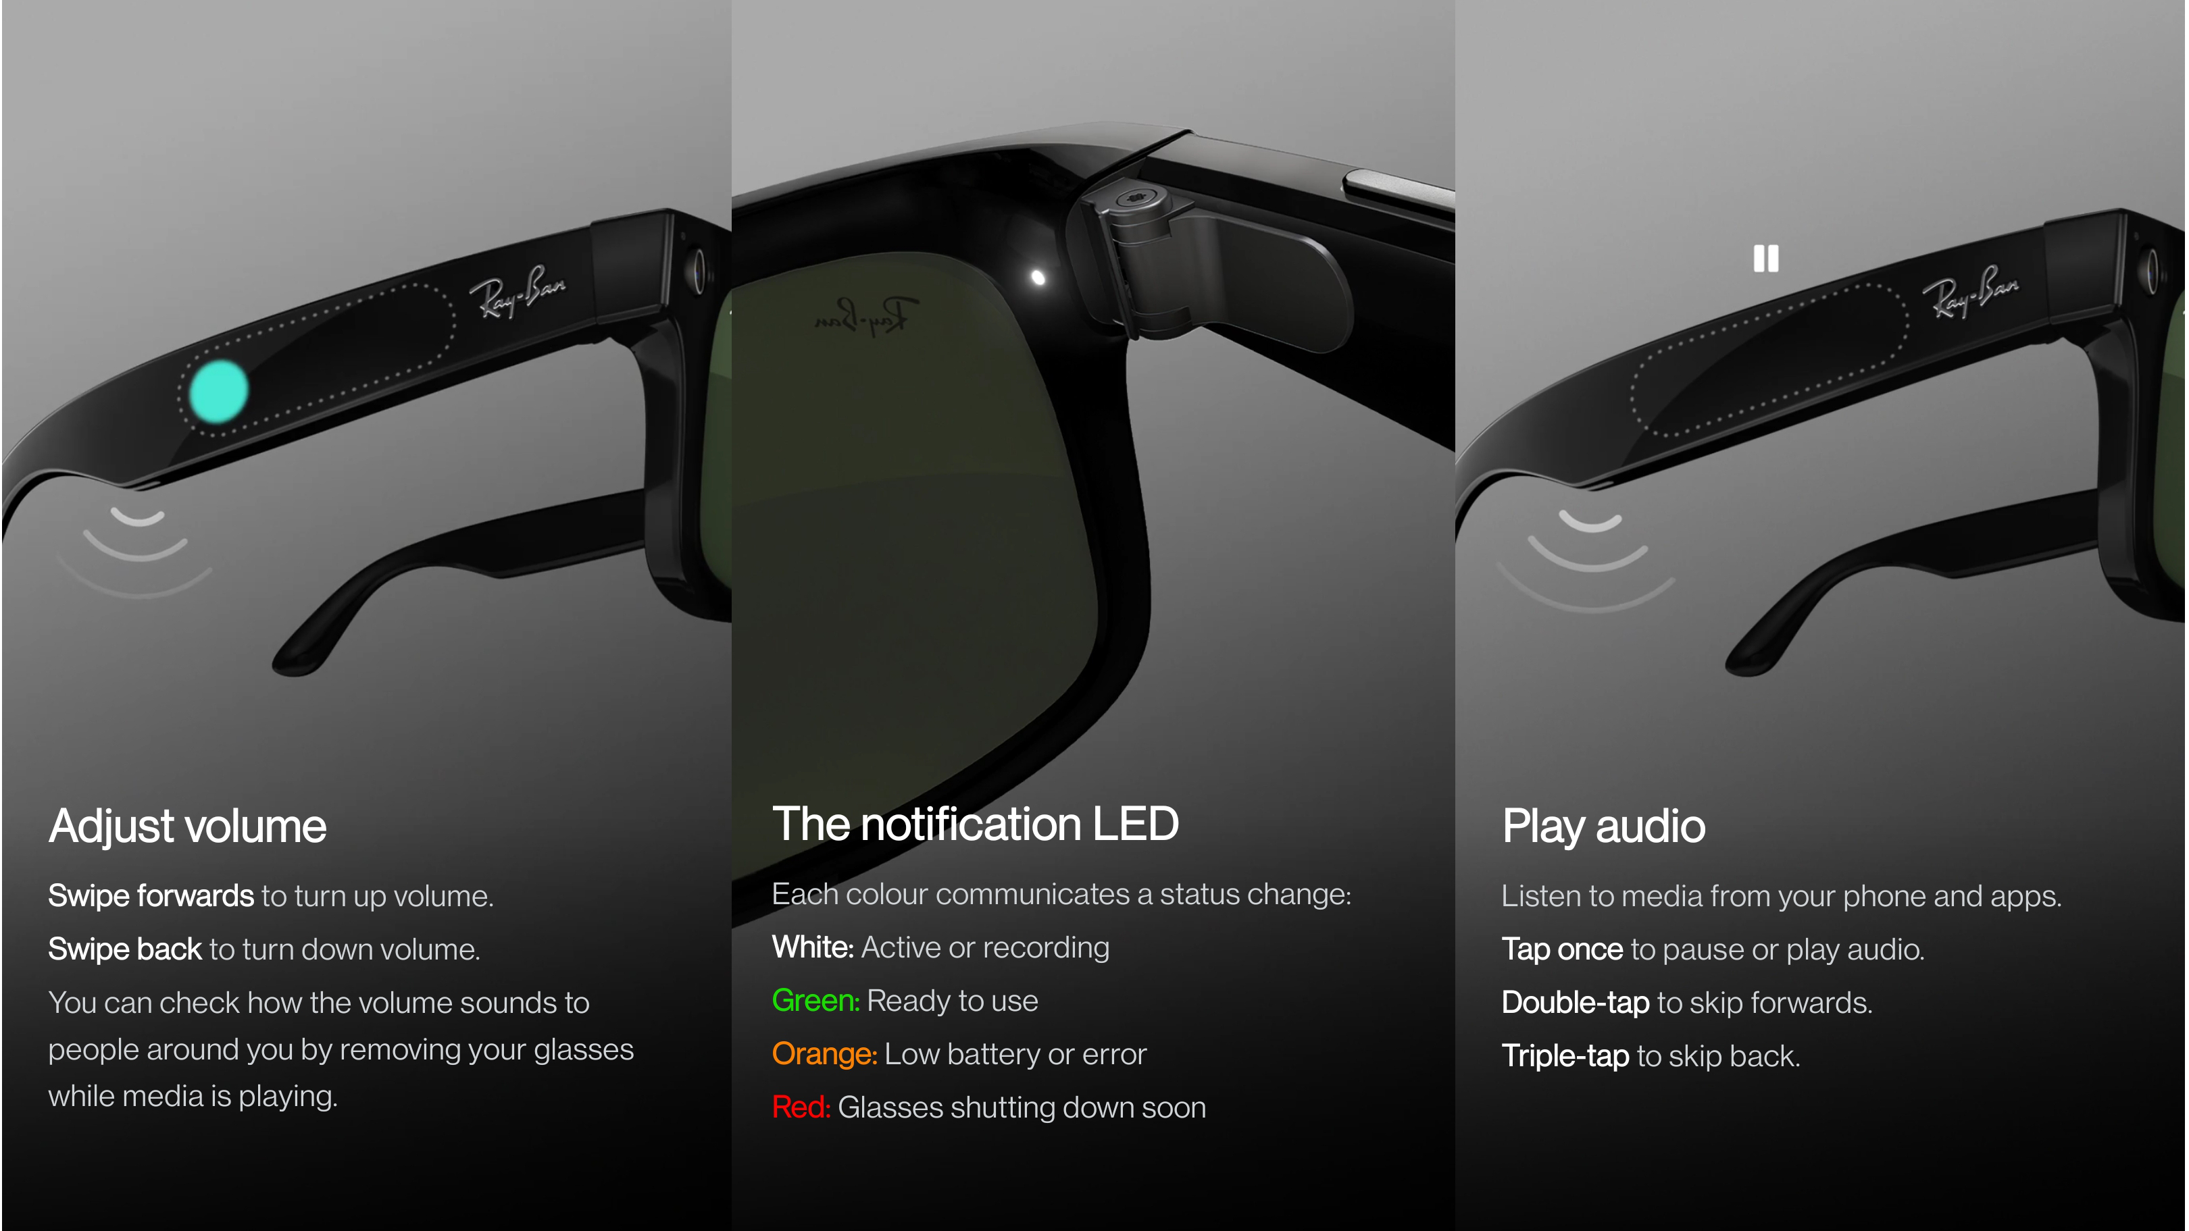
Introduction
Key Features
Real-time facial recognition and data retrieval.
Seamless integration with mobile apps.
Demonstrates the power of data aggregation.
Why is it Important?
Highlights risks of unregulated facial recognition technology.
Questions the balance between public visibility and personal privacy. Sparks discussion on ethical and regulatory challenges.

Slide 4
Objective
Expose Vulnerabilities in Privacy
Highlight Ethical Concerns
Educate on Real-Time Privacy Risks
Stimulate Policy Reform Discussions
Promote Responsible Innovation
Encourage Public Awareness

Slide 5
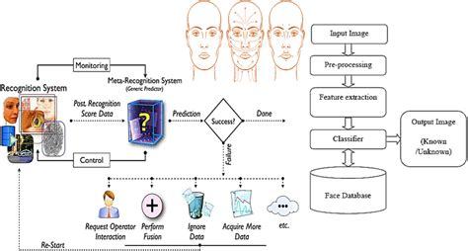
Technological Framework
Smart Glasses Integration
Meta’s Ray-Ban smart glasses equipped with high-resolution cameras and sensors.
Real-time image capture and transmission capabilities.
Facial Recognition Algorithms
Advanced AI-driven algorithms (e.g., PimEyes) for rapid and accurate facial identification.
Utilization of convolutional neural networks (CNNs) trained on large datasets.
Data Aggregation
Retrieval of personal information from publicly available sources such as social media, public records, and online directories.
Automated scraping and API integration for seamless data compilation.
Mobile Application
User-friendly interface to display consolidated personal information in real-time.
Customizable filters for prioritizing data categories.

Slide 6

Key Components
Smart Glasses Design and Features:
Meta's Ray-Ban glasses with discreet high-resolution cameras.
Connectivity: Integrated with Bluetooth and Wi-Fi for seamless data transmission.
Future Enhancements: Potential addition of LiDAR sensors for improved depth perception.
Facial Recognition Technology
AI Algorithms: Sophisticated CNNs trained on diverse datasets for precise face matching.
Processing Speed: Real-time matching optimized for minimal delay.
Challenges: Potential biases in datasets affecting accuracy across demographics.
Data Compilation
Sources: Publicly available datasets, social media, and government records.
Automation: Use of APIs and scraping tools for rapid data retrieval.
Ethical Concerns: Aggregation raises issues around consent and privacy rights.
Mobile Application
Interface: Displays consolidated data like name, address, and social profiles.
Customization: Users can filter and prioritize displayed data.
Security: Biometric authentication to restrict unauthorized access.
Notes:
warbwargbwrebwbwbwbbwv

Slide 7
System Functionality
Image Capture
Smart glasses continuously scan the environment for faces.
Enhanced focus and lighting adjustments for high-quality image capture.
Operates discreetly, raising privacy concerns about informed consent.
Facial Recognition
Captured images are processed locally or in the cloud.
Algorithms extract unique facial features to create a "facial signature”.
Matches are made against extensive online databases in milliseconds.
Data Retrieval
Automatic searches in public records, social media profiles, and government databases.
Data types include names, addresses, phone numbers, and affiliations.
Real-time prioritization of relevant information.
Information Display
Consolidated data presented in a user-friendly mobile application.
Customizable display options, allowing users to filter specific categories.
Secure access ensured through biometric authentication.

Slide 8
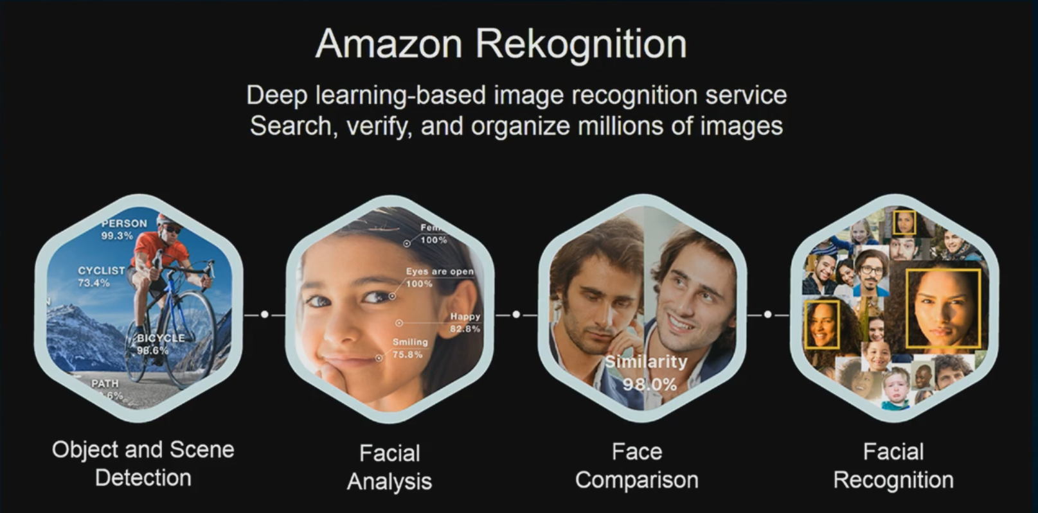
Societal and Ethical Implications
Clearview AI
Compiled images from public sources for law enforcement use.
Faced criticism for privacy violations and unauthorized data scraping.
Legal challenges in Europe and bans in countries like Canada.
China's Surveillance System
Nationwide use of facial recognition linked to the social credit system.
Benefits in crime reduction but criticized for authoritarian overreach.
Suppresses freedom of expression and targets dissidents.
Amazon Rekognition
Provides facial recognition services for law enforcement and businesses.
Proven biases, especially in identifying women and people with darker skin tones.
Amazon halted sales to law enforcement following public backlash.

Slide 9
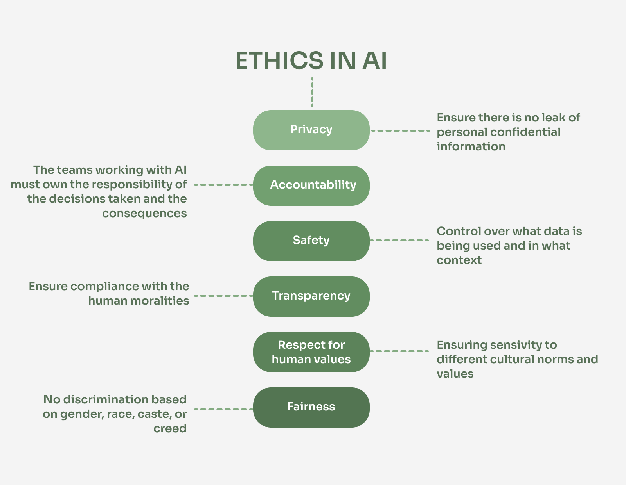
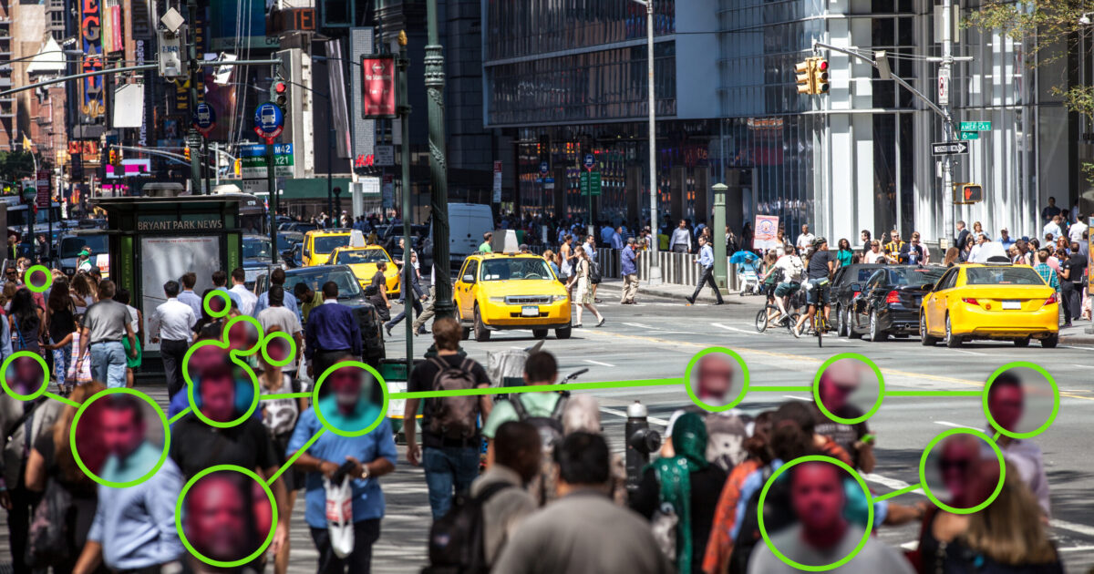
Societal and Ethical Implications
Privacy Concerns
Facilitates real-time identification without consent.
Undermines anonymity in public spaces.
Psychological Impacts
Increases social anxiety and distrust in public settings.
Promotes behavioural changes to avoid surveillance.
Ethical Dilemmas
Lack of informed consent in data usage.
Raises questions about ownership and misuse of public data.

Slide 10
Regulatory Challenges & Solutions
Challenges:
Gaps in Current Laws: GDPR and CCPA do not address real-time facial recognition.
Anonymity Erosion: No clear legal protection for public anonymity.
Data Aggregation Loopholes: Public data usage lacks ethical boundaries.
Wearable Devices: Insufficient regulation for AI-integrated gadgets.
Solutions:
Global Standards: Develop international ethical frameworks for AI and privacy.
Consent Protocols: Mandate informed consent for data usage.
Enhanced Oversight: Implement audits and compliance checks for technology developers.
Anonymity Rights: Introduce laws protecting privacy in public spaces.

Slide 11
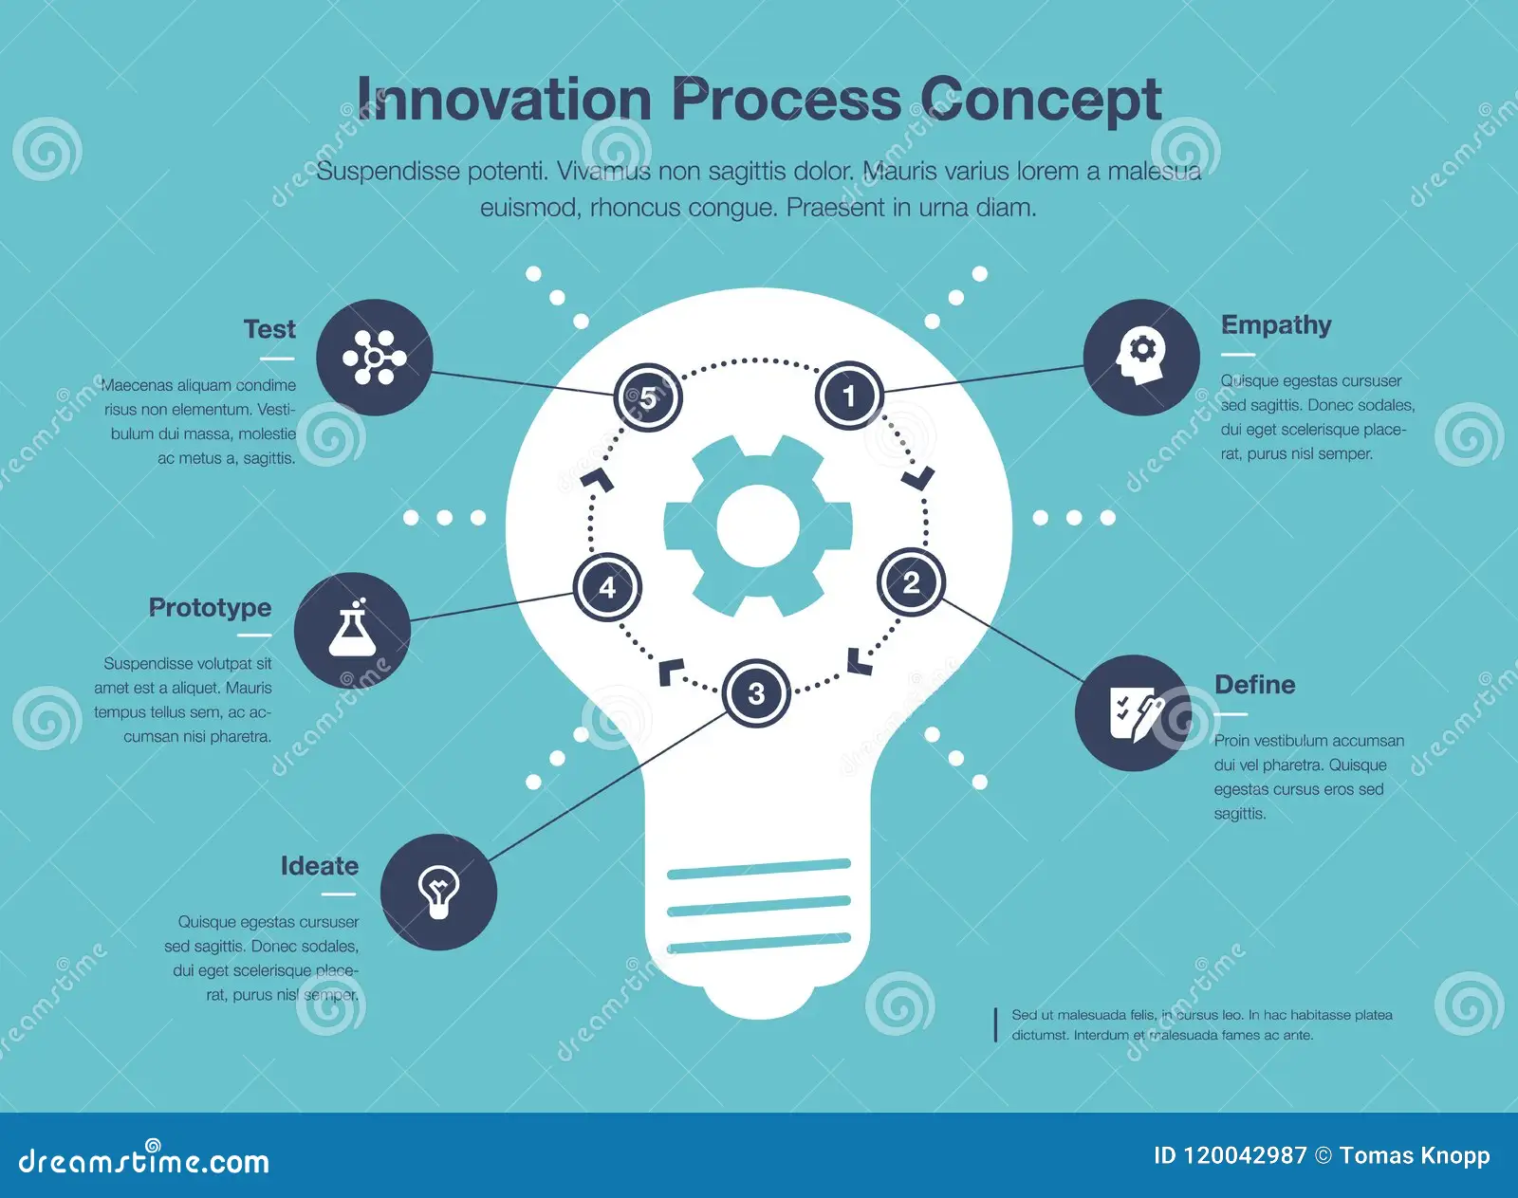
Future Outlook
Technological Advancements:
AR integration for real-time contextual data.
Counter-surveillance tools like adversarial fashion.
Blockchain for decentralized identity management.
Societal Changes:
Greater emphasis on privacy-focused tech.
Behavioural shifts to avoid surveillance.
Demand for ethical AI in corporate practices.
Regulatory Developments:
Global standards for AI and privacy.
Stricter accountability for tech developers.
Laws to prevent misuse of public data.

Slide 12
conclusion
Technology’s Dual Role: I-XRAY exemplifies how innovation can challenge privacy and ethical norms.
Regulatory Needs: Existing frameworks like GDPR and CCPA are insufficient for addressing real-time AI technologies.
Ethical Responsibility: Developers must prioritize transparency, consent, and accountability to mitigate misuse.
Public Awareness: Educating individuals about data privacy is essential to empower informed choices.
Collaboration for Balance: Governments, tech leaders, and society must align to ensure technology serves humanity without infringing on rights.
Vision for the Future: A privacy-conscious digital world is achievable with ethical foresight and responsible innovation.

Slide 13
Thank you

